Slide 1
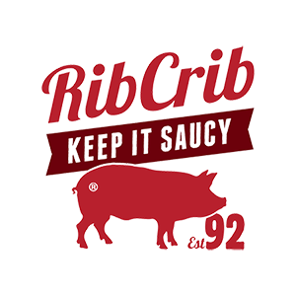

RibCrib
Business Model
Alina Rozenbaum

Slide 2
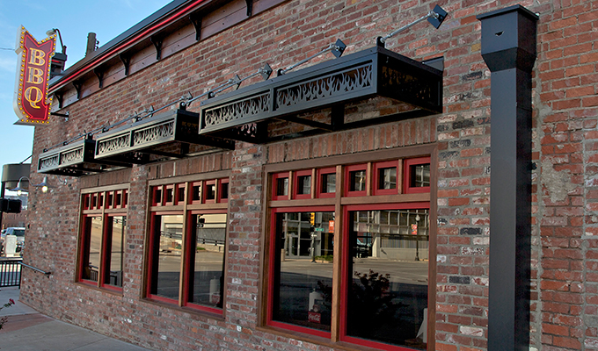
Getting Started
Brett chandler – 1992
Hickory Wood fire smoker in an old house
5 meat options and 2 side options
Notes:
http://franchise.ribcrib.com/

Slide 3
Important Information
Privately owned
Oklahoma, Texas, New Mexico, Kansas, Missouri, Arkansas, Iowa and Florida
Keys
Atmosphere
Homemade smoked meat
Unique sauces and rubs
Listed in the
Restaurant Business ‘Top 50 Growth Chains’
Chainleader ‘One of the best places to work’
Notes:
http://franchise.ribcrib.com/
https://www.franchisehelp.com/franchises/rib-crib-barbecue/
http://ribcrib.com/

Slide 4
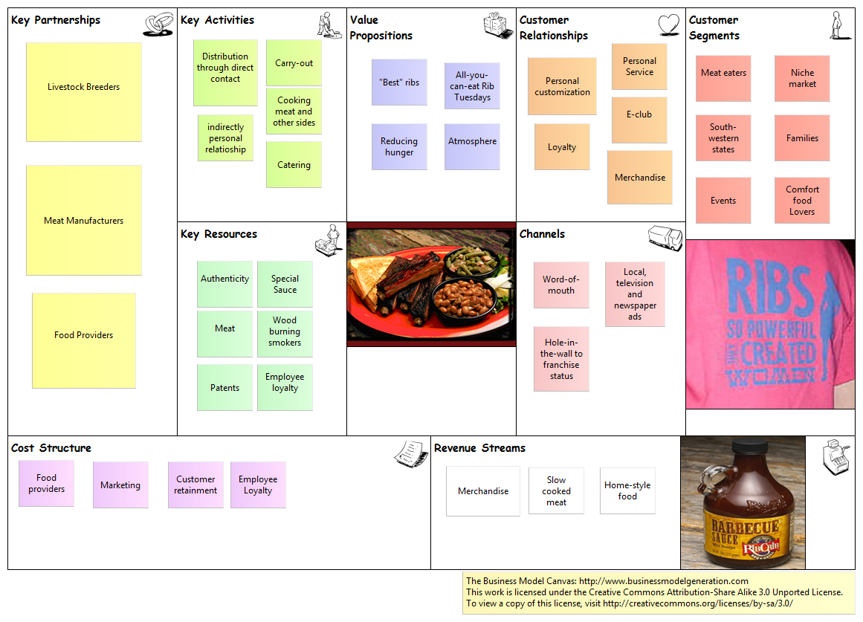
Business Canvas
Summarize your market in the past, present, and future.
Review those changes in market share, leadership, players, market shifts, costs, pricing, or competition that provide the opportunity for your company’s success.
Notes:
http://franchise.ribcrib.com/
https://www.franchisehelp.com/franchises/rib-crib-barbecue/
http://ribcrib.com/

